Slide 1
Digital Image Processing
Road Extraction From Satellite Images

Slide 2
Introduction
Road Extraction from Satellite Images has important application in modern day navigation with ever growing maps and their uses to locate.
Hence, it becomes tiresome to extract roads from the satellite image manually

Slide 3
Proposed Algorithm
Spectral angle Transformation
Input: Multispectral Image
Output: Spectral Angle based Image
Preparing Image for Edge Detection
Median filtering
Image to Binary Conversion
Edge Detection
Sobel Operator
Canny Edge Detection
Morphological Operations
Image-Eroded(image)

Slide 4
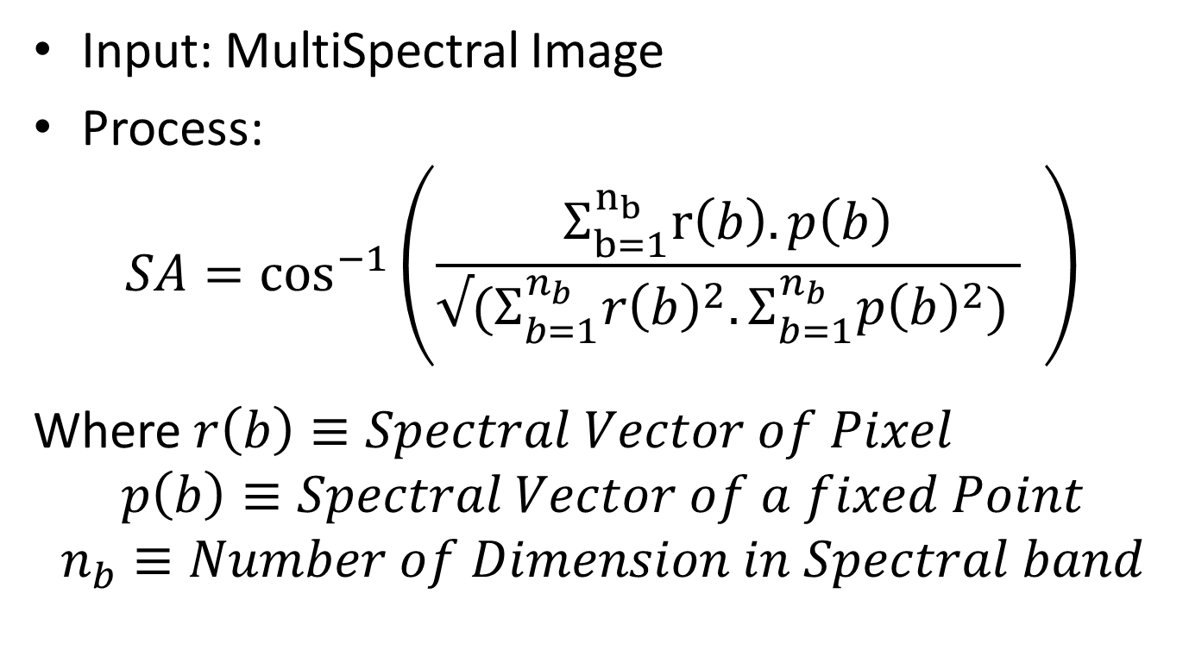
Spectral Angle Transformation
Input: MultiSpectral Image
Process:
$$SA=\cos^{−1}{\begin{aligned}\left({{\frac{Σ_{b=1}^{n_{b}}r\left(b\right).p\left(b\right)}{{√(Σ}_{b=1}^{n_{b}}r{\left(b\right)}^{2}. Σ_{b=1}^{n_{b}}p{\left(b\right)}^{2}) }}_{ }}_{ }^{}\right) \\ \end{aligned}}$$
Where $r\left(b\right)≡Spectral Vector of Pixel$
$$p\left(b\right)≡Spectral Vector of a fixed Point$$
$$n_{b}≡Number of Dimension in Spectral band$$

Slide 5
RGB vs LAB Color Space
RGB is an additive colour space
Used mainly in preparing colors for machines
Does not include illumination
LAB color is color Space as percieved by humans
It is better for color segmentation because it helps in matching of the colors better
Includes illumination.

Slide 6
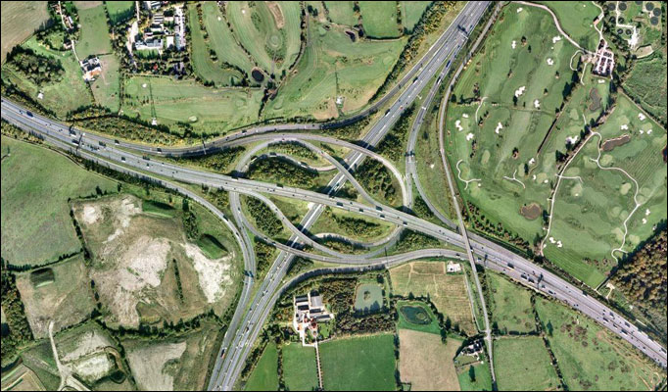

Slide 7
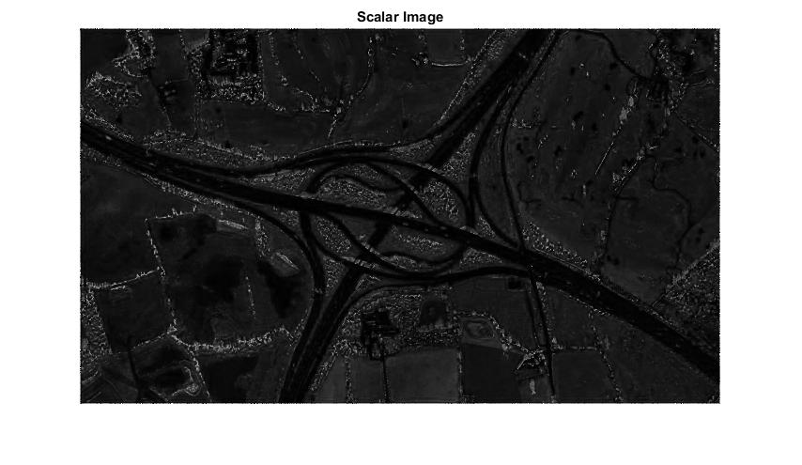

Slide 8
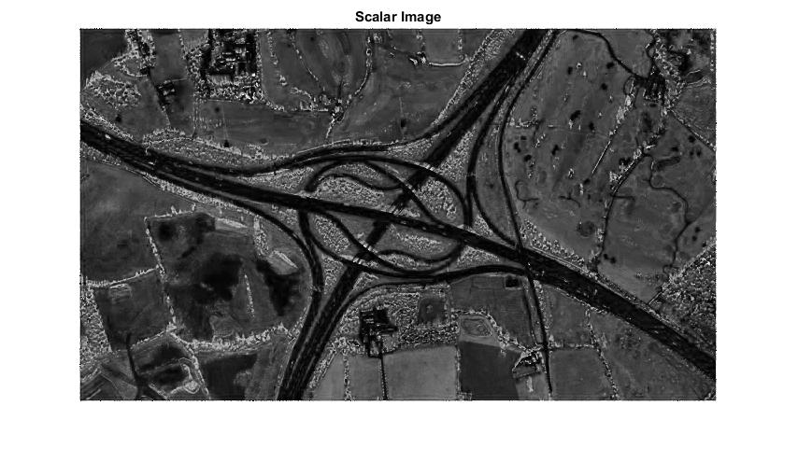

Slide 9
Preparing Image for Edge Detection
Median Filtering
Conversion to Binary
Using LAB space gives us freedom of setting a higher threshold
Morphological Operations
Removal of small areas: Number of pixels<200
Bounding Box to remove Larger areas
Attempts at Segment Linking

Slide 10
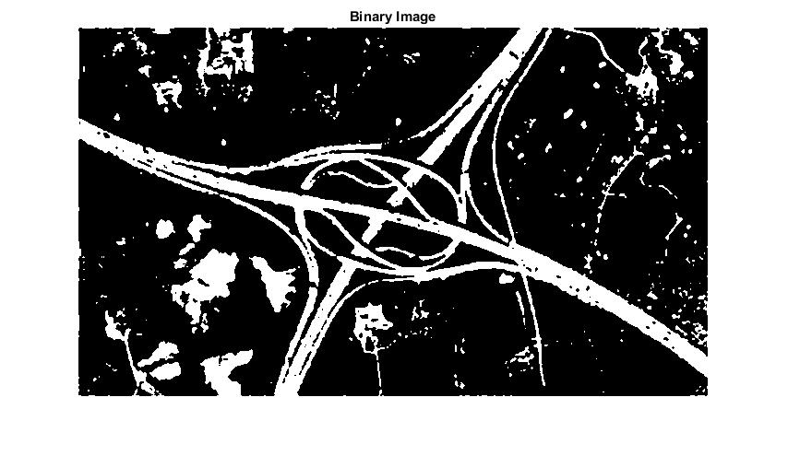

Slide 11
Morphological Operations-Bounding Box
After removing small connected components, there yet remained noise with larger number of concentrated Pixels
Calculate Bounding Box for each of the connected components.
If neither the length nor width of the Bounding Box is greater than 1/3rd of the image, Remove that component
Generally roads form a larger part of the images travelling from one end to other
Sometimes, the roads are not fully connected. Balance needed

Slide 12
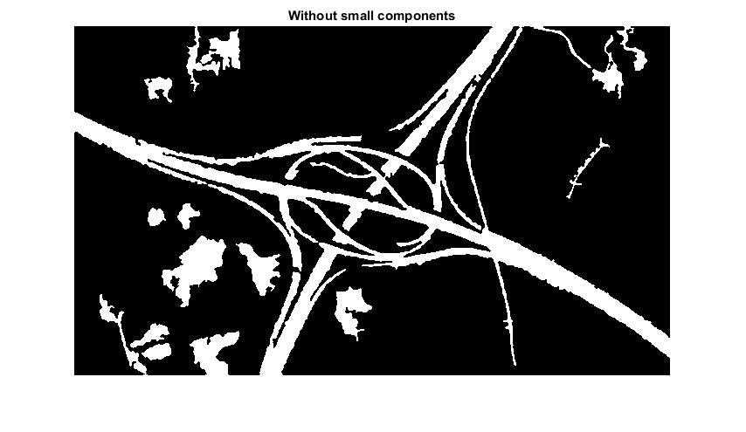

Slide 13
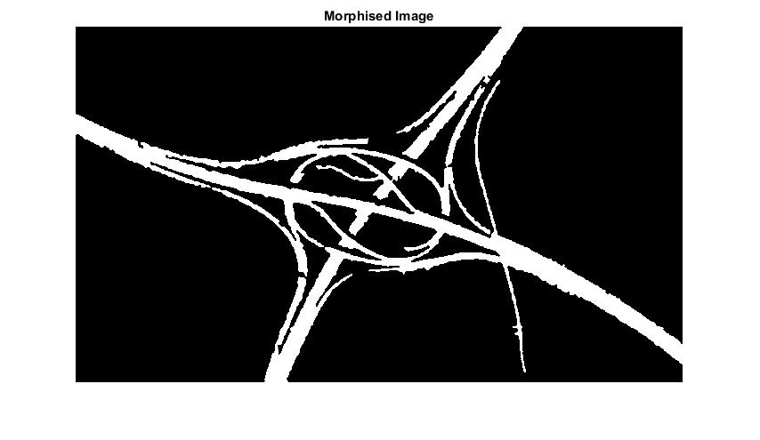

Slide 14
Attempts at Segment Linking-Dilation
Joining the cut segments using the process of Dilation.
Dilation leads to thickening of the roads as well.
Need a Better solution

Slide 15
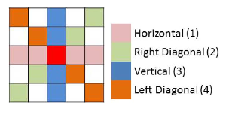
Special Dilation(and Erosion)
Calculate mean intensity at each pixel for each of the directions
Calculate Standard Deviation for each pixel for each direction
Select the direction with lowest Standard Deviation
Chose maximum value along that direction
1 | 0 | 1 | 0 | 1
0 | 1 | 1 | 1 | 0
1 | 1 | 1 | 1 | 1
0 | 1 | 1 | 1 | 0
1 | 0 | 1 | 0 | 1

Slide 16
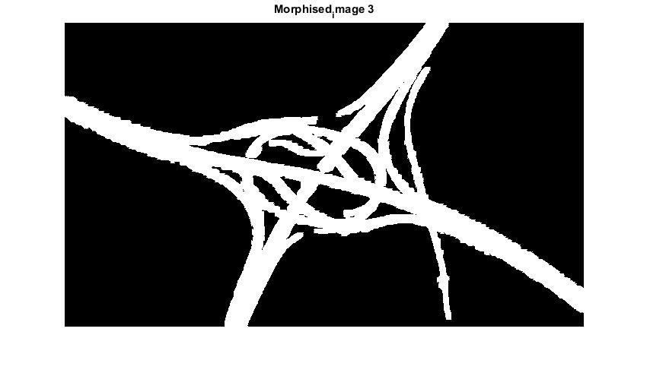

Slide 17
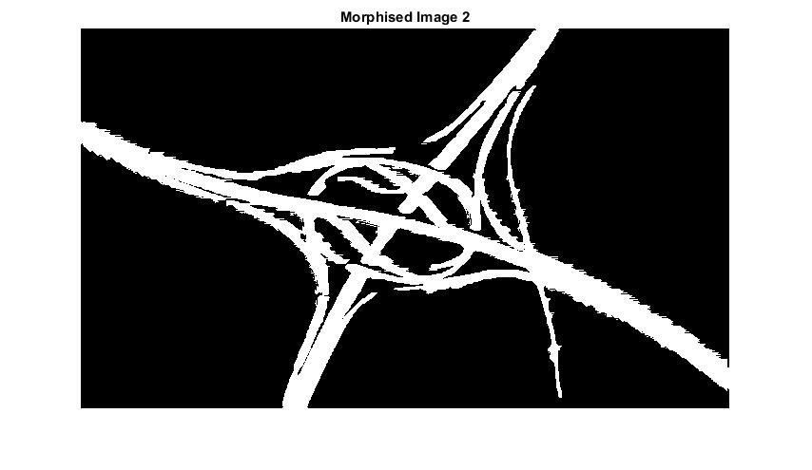

Slide 18
Skeleton Approach
As we saw, Special dilation links small gaps if there exist a small line link between two ends
We looked at components in sub-images of sizes -40X40 at an interval of 20.
Joined the loose ends of the components in case of the smallest distance.
Could not work out for the branch points.

Slide 19
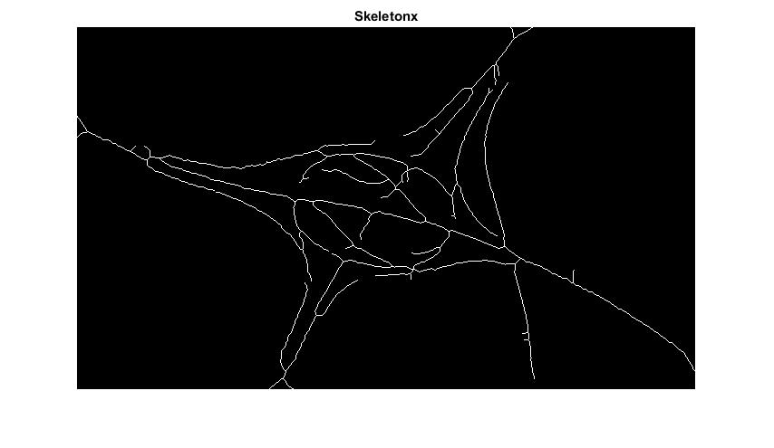

Slide 20


Slide 21
Edge Detection- Sobel Operator

Slide 22


Slide 23
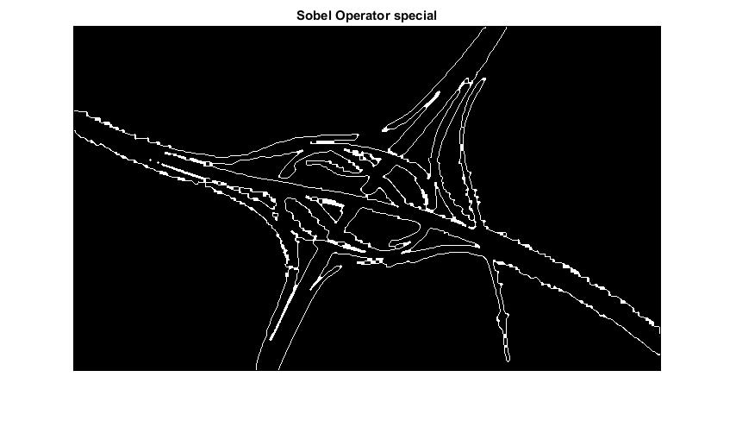

Slide 24
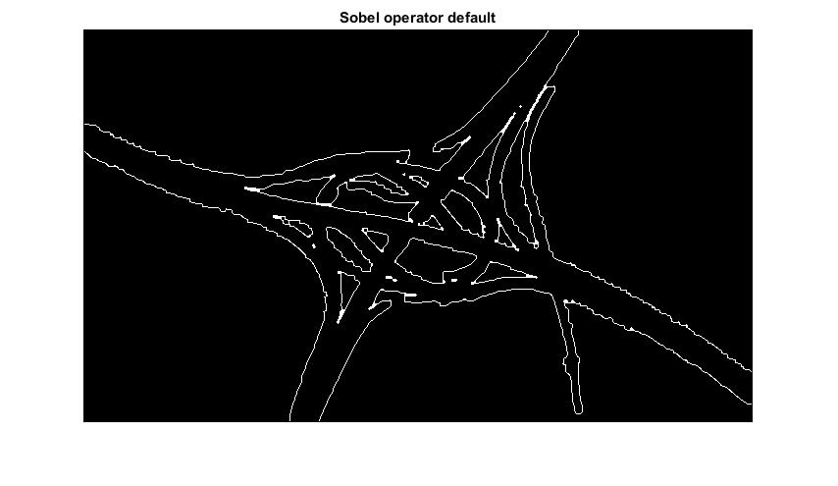

Slide 25
Edge Detection- Canny Edge Segmentation

Slide 26
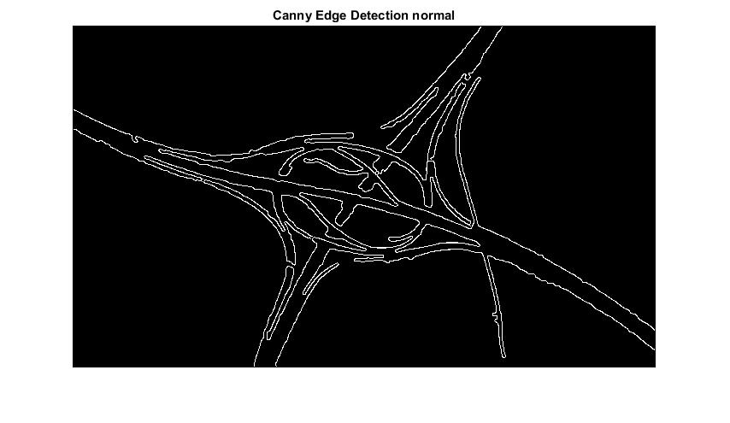

Slide 27


Slide 28


Slide 29
Edge Detection – Eroded Images

Slide 30


Slide 31
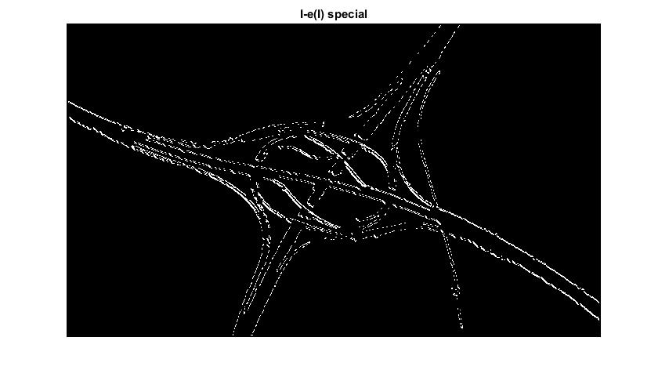

Slide 32
References
Deepthy Mary Alex, “Robust and Efficient Method to Extract Roads from Satellite Images”
D. Chaudhuri, N. K. Kushwaha, and A. Samal, “Semi-Automated Road Detection From High Resolution Satellite Images by Directional Morphological Enhancement and Segmentation Techniques”
Matlab Help-http://www.mathworks.com/

